Slide 1
Project 3: A Review and Report on Safe Programming Tools.
Hongtao Hua
CS3281 Operating System

Slide 2
Memory leak and Concurrency Error
A memory leak is a type of resource leak that occurs when dynamically allocated memory has become unreachable.
A concurrency error is the result of incorrect synchronization safeguards in multi-threaded software.

Slide 3
Garbage Collection vs. C/C++ Style memory management
Garbage Collection: Automatic memory recycle
Easy to use but create overhead
C/C++ Style: Require manual memory management
Require extra work but can be precise and efficient

Slide 4
Memcheck, Electric Fence and Helgrind
Memcheck and Electric Fence can check memory management issue
Memory Leak (example1)
Dangling pointer (example2)
Buffer overflow (example 4 )
Helgrind can check synchronization error
Deadlock(example 5)
Data Race(example 6)

Slide 5
Advantages
Memcheck can detect accessing of unauthorized memory, using of undefined values, incorrect freeing of heap memory, mismatch use of malloc/new and memory leaks.
Electric fence can detect software that overruns the boundaries of a malloc()memory allocation, and software that touches a memory allocation that has been released by free().
Helgrind can detect the synchronization errors.

Slide 6
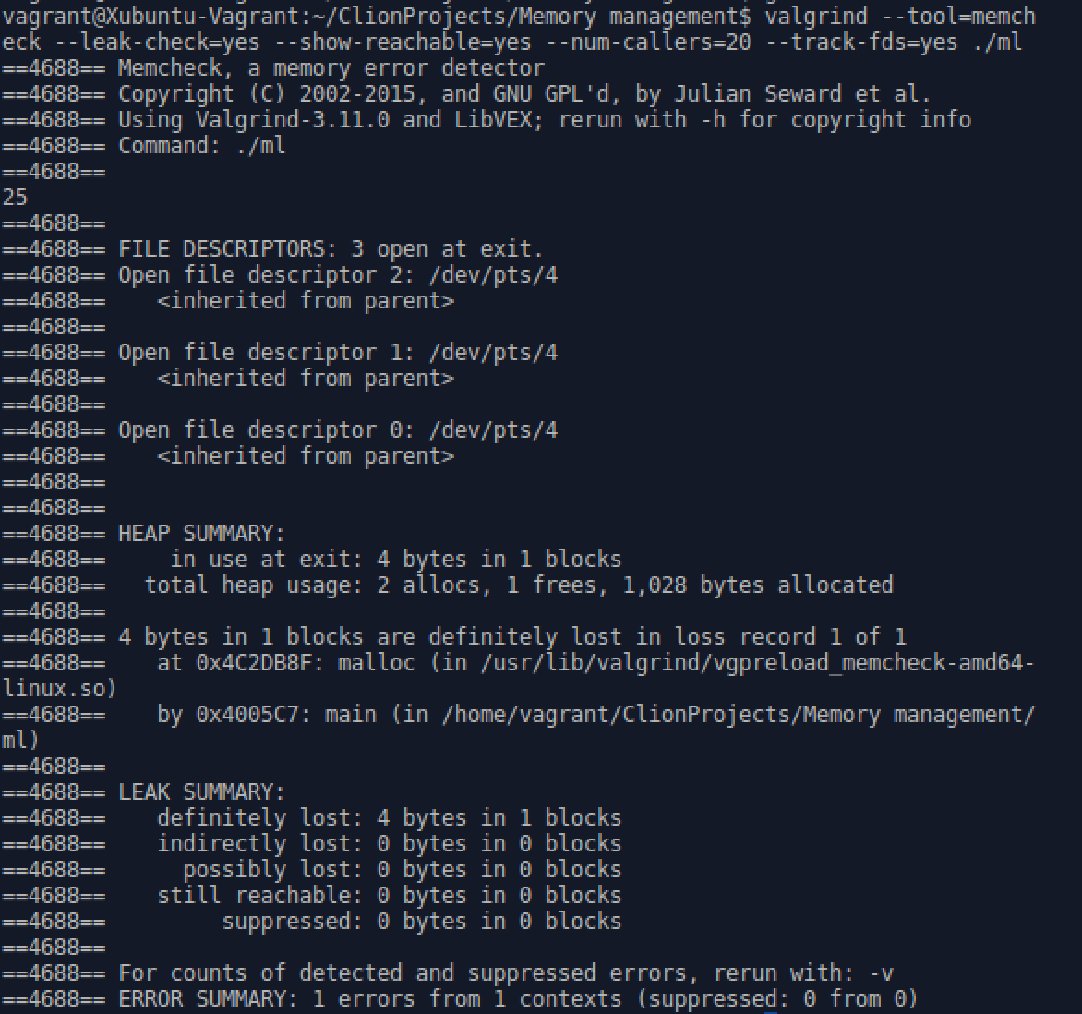
Sample output
Memcheck

Slide 7
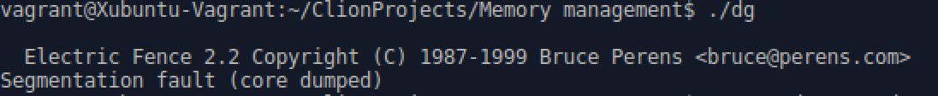
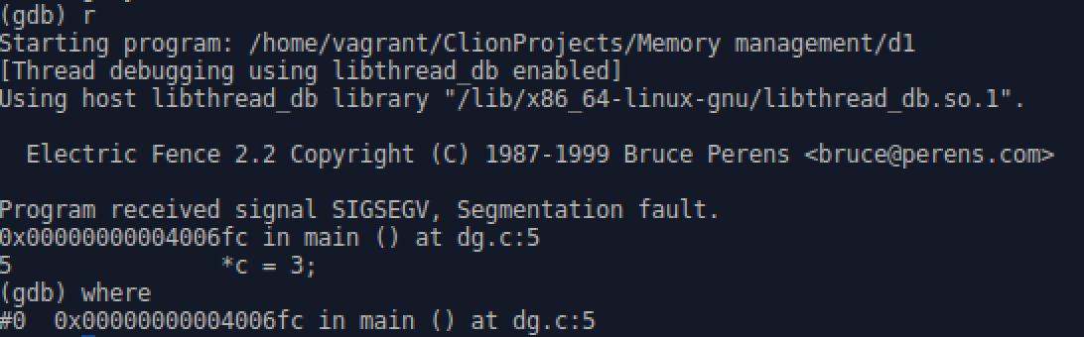
Sample output 2
Electric Fence

Slide 8
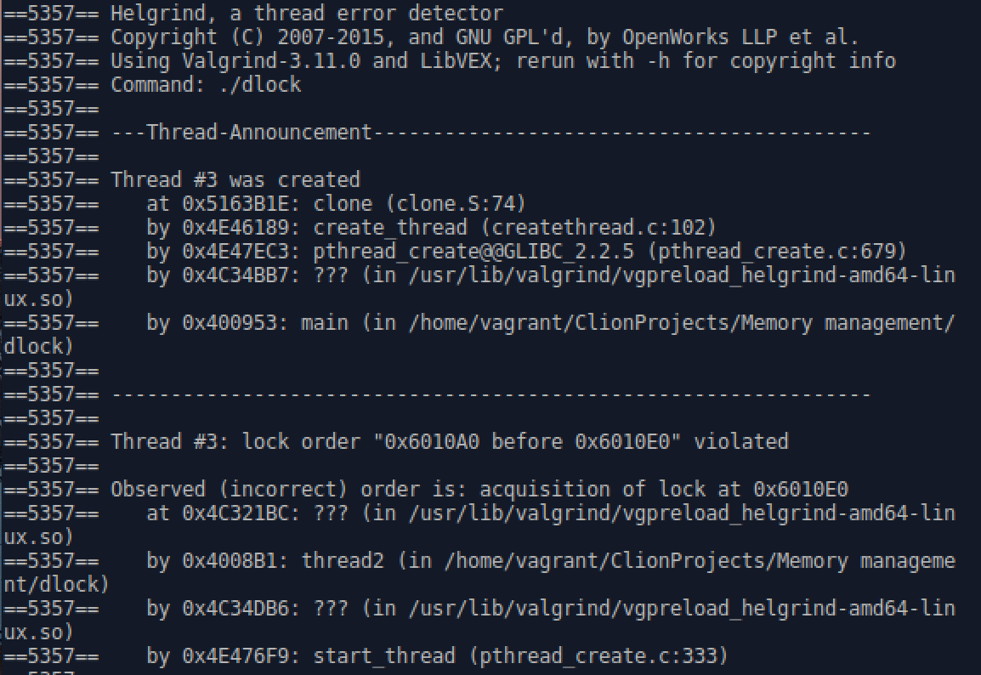
Sample output 3
Helgrind

Slide 9
Summary
All three debuggers have their advantages as well as limitations.
Automatic memory management and manual memory management have advantages and limitations as well.
Programmer should use the correct debugger depending on the situation.

